Slide 1
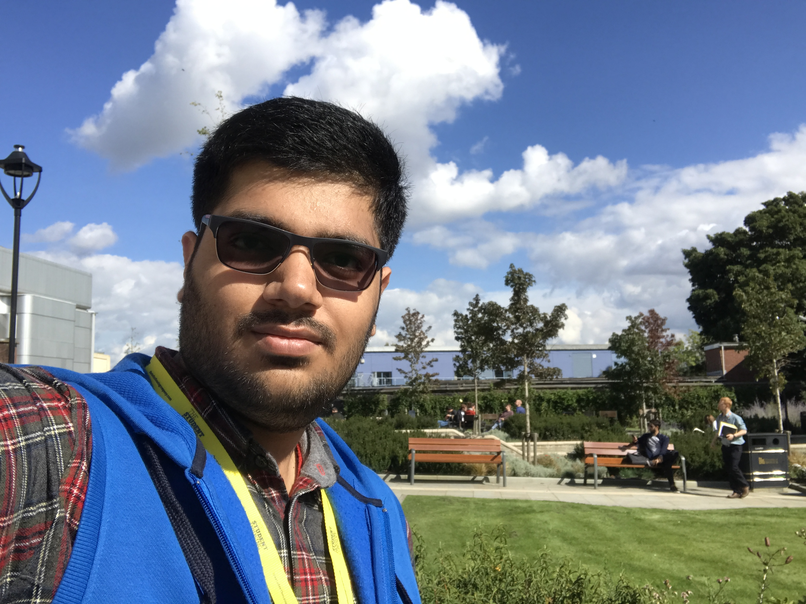

Understanding and Implementing Generative Adversarial Networks (GANs): One Of The BIGGEST Breakthroughs In The Deep Learning Revolution
PyConThailand | 2019
Anmol Krishan Sachdeva
Platform Software Engineer - Bigbasket, India
MSc Advanced Computing, University of Bristol, UK
Email Id: greatdevaks@gmail.com
LinkedIn: https://www.linkedin.com/in/greatdevaks
Twitter: https://www.twitter.com/greatdevaks
GitHub: https://www.github.com/greatdevaks

Slide 2

About Me
PYCON
THAILAND
Currently, working as a Platform Software Engineer at Bigbasket, India (India's largest online food and grocery store).
MSc in Advanced Computing (Machine Learning, Artificial Intelligence, Robotics, Cloud Computing, and Computational Neuroscience) from University of Bristol, United Kingdom.
International Tech Speaker (spoke at numerous International Conferences like GeoPython, 2018, and EuroPython, 2018, and more).
Former Software Developer Intern at IBM & an ALL STACK DEVELOPER capable of designing and developing solutions for Mobile, Web, Embedded Systems, and Desktop.
Represented India at International Hackathons like Hack Junction’16, Finland and Hack the North’16, Canada. Got invited for more than a ‘dozen’ of prestigious International Hackathons (PennApps’17, HackNY’17, Hack Princeton’17 and many more) and Conferences.
Microsoft Certified Professional, Microsoft Technology Associate, IBM Certified Web Developer, and Hewlett Packard Certified Developer.
8+ International Publications [Latest work got published in ACM CHI 2018. The project was exhibited in Montreal, Canada.].
Received 6 Honours and Awards (International and National level).

Slide 3
Flow of the Talk
PYCON
THAILAND
A Succinct Prelude to Deep Learning (DL).
A Brief Introduction to Adversarial Training.
Understanding Discriminative and Generative Models.
Working and Architecture of Generative Adversarial Networks (GANs).
Quick Hands-on and Code Walkthrough (using Python).
Tips to Train GANs Better.
Applications of GANs.
Roadmap to Further Study About GANs.
End of Talk followed by Questions and Answers Session.
10 Minutes
20 Minutes
10 Minutes

Slide 4
Pre-requisites
PYCON
THAILAND
Basic understanding of Python language and TensorFlow.
Knowledge of Artificial Neural Networks (better if having experience with Convolutional Neural Networks).
Elementary Linear Algebra, Calculus, and Statistics.

Slide 5
Introduction to ANNs and DL
PYCON
THAILAND
Artificial Neural Networks (ANNs) are the computing systems that are highly influenced by the biological neural circuits (the neural connections in the brain).
The neural networks enable a machine to learn patterns from some given observational data and to perform various tasks based on that learning.
For example, a neural network can help in predicting the future stock prices of a company after being trained with the company’s stock prices data of the past few years.
Deep Learning (DL) is a set of powerful methods that are used for learning in the neural networks.

Slide 6
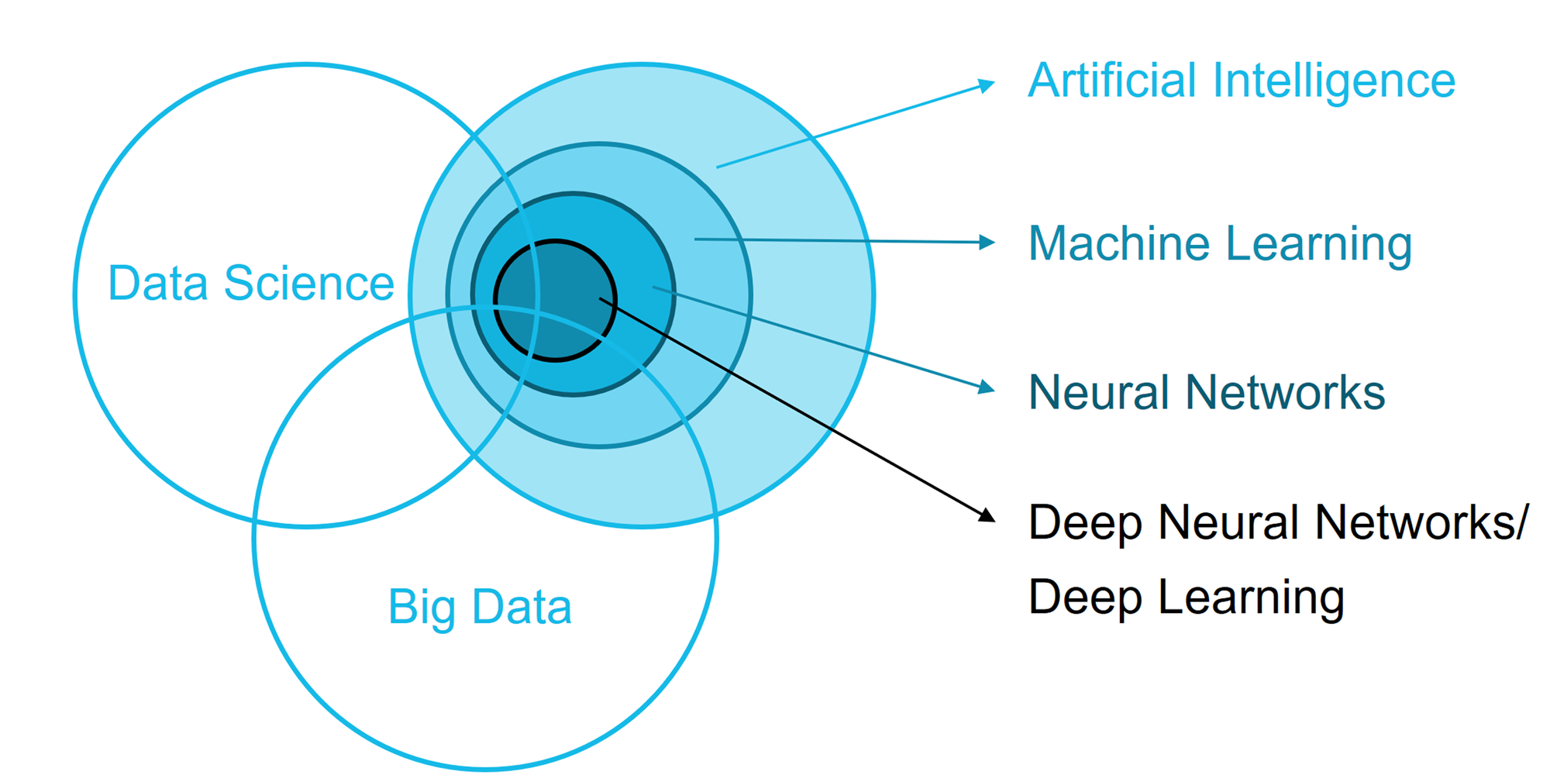
The Big Picture
PYCON
THAILAND
Source: https://www.fokus.fraunhofer.de/en/fame/workingareas/ai

Slide 7

Common Types of Neural Networks
PYCON
THAILAND
Some common types of neural networks are stated below:
Feed Forward Neural Networks.
Recurrent Neural Networks.
Convolutional Neural Networks.
Auto-Encoders.
Markov Chain Models.
Boltzmann Machines.
Generative Adversarial Networks.
And many more…
The Neural Network Zoo
Detailed Information: https://www.asimovinstitute.org/author/fjodorvanveen/

Slide 8

The Important Part Starts…
A Brief introduction to adversarial Training

Slide 9

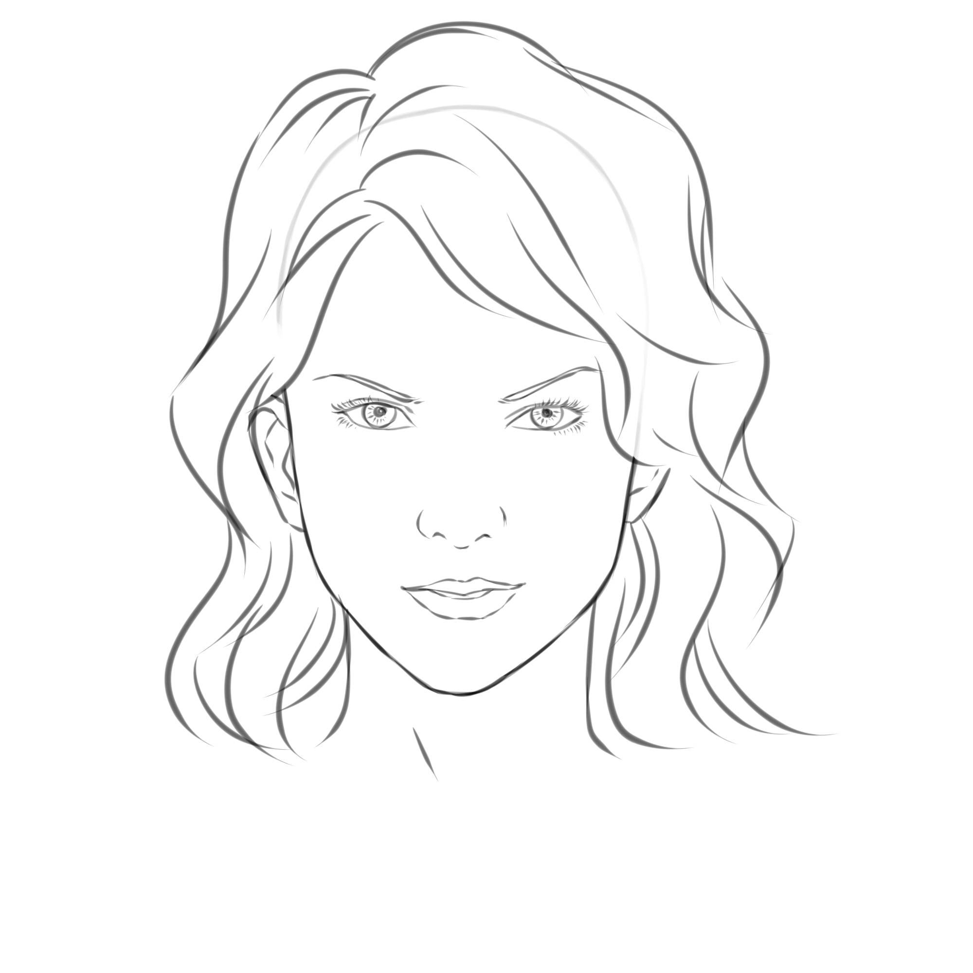


Story of a Counterfeiter
PYCON
THAILAND
Mary
First Sketch
John
Mona Lisa

Slide 10
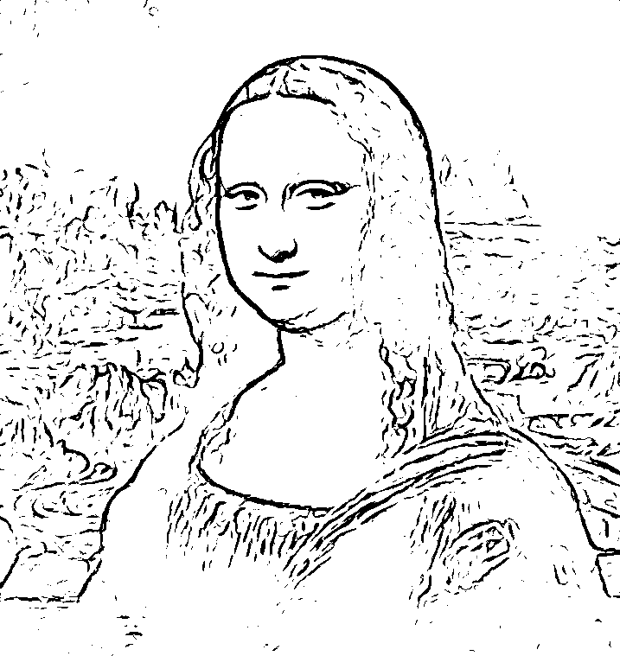
Story Continued…
PYCON
THAILAND
Mary
Tenth Sketch
John
Mona Lisa

Slide 11
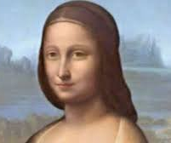
Mary Gaining Perfection…
PYCON
THAILAND
Mary
Fiftieth Sketch
John
This looks a bit real. I am confused.
Mona Lisa

Slide 12
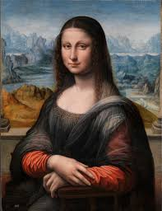

Finally, Mary fooled John
PYCON
THAILAND
Mary
Hundredth Sketch
John
Mona Lisa

Slide 13
Discriminative and Generative Models
PYCON
THAILAND
A Discriminative Model is a supervised learning based model which observes the data and learns to classify the data. These models don’t stress much on the data distribution but on the quality of data.
A Generative Model can be defined as a model (think of it to be like a mathematical representation of a real-world process) that is used to generate data which seems real.
Generative Models are able to learn mostly any kind of data distribution using unsupervised learning.
A large amount of data in some domain (like images, audio, sequences) is used for training the generative model and the model learns the underlying data distribution. After learning the data distribution, the model is able to generate the data which looks real.

Slide 14
Continued…
PYCON
THAILAND
In nutshell, a Discriminative Model models the decision boundary between the classes. On the other hand, a Generative Model models the actual data distribution of each class.
A Discriminative Model is good at classifying/categorizing the data, whereas, a Generative Model is good at producing very similar data distribution.

Slide 15
Generative Adversarial Networks
PYCON
THAILAND
Generative Adversarial Networks are formed by combining a Discriminator (network using a Discriminative Model) and a Generator (network using a Generative Model) in form of a network.
The goal of a GAN is to sample from a simple distribution (say a Normal Distribution) and then learn a complex transformation from simple distribution to the training distribution (training distribution is provided in form of bulk training data).

Slide 16
GANs Continued…
PYCON
THAILAND
I
N
P
U
T
GAN
(learns complex transformation)
O
U
T
P
U
T
Sample Distribution [m dimensional]
Z ~ N(0, I): Normal Distribution (say)
Generated Sample [n dimensional]

Slide 17
Training a GAN
PYCON
THAILAND
We use a two players game in order to train a GAN.
One player is a Generator. The job of the generator is to take a sample distribution (latent space) and through a complex transformation (using a neural network), learn the training distribution i.e. generate a real looking sample.
Other player is a Discriminator. The job of the discriminator is to get better and better at distinguishing between the “REAL” sample and the “FAKE” sample.
The generator tries to produce samples that look so natural that the discriminator thinks that the samples came from the real data distribution.
Try to correlate this scenario with the story of “Mary the Counterfeiter” and “John the Investigator”. Mary can be considered as the Generator and John can be considered as the Discriminator.
GAN training becomes successful when the Discriminator is not able to distinguish between the real and the generated samples. This happens because the Generator learns the training data’s distribution very well.

Slide 18

The Intuition and Setup
PYCON
THAILAND
Source: https://skymind.ai/wiki/generative-adversarial-network-gan

Slide 19
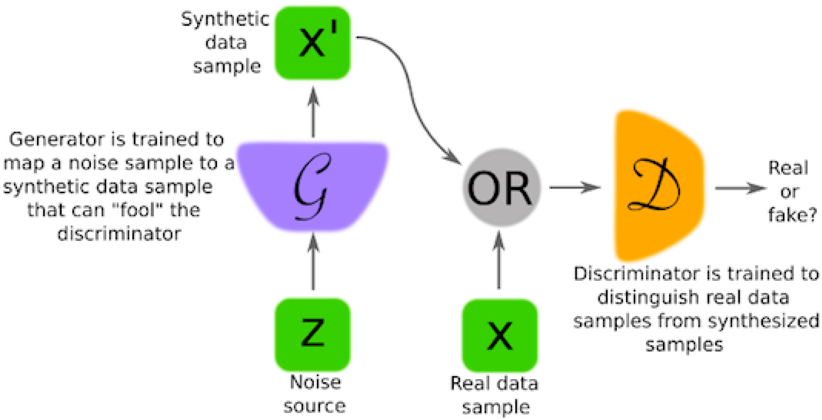
Diving into Mathematics of GANs
PYCON
THAILAND
Let Gф denote the Generator and Dθ denote the Discriminator. Here, ф and θ are the parameters of G and D, respectively.
The Discriminator assigns its input a score between 0 and 1 => this tells the probability of the sample being real or fake.
The Generator always wants the score given by the Discriminator to be highest i.e. equal to 1.
D θ(X)
or
Gф(z)
D θ(Gф(z))
(1)
(0)
z ~ N(0, I)

Slide 20
Mathematics of GANs
PYCON
THAILAND
D θ(X)
or
Gф(z)
D θ(Gф(z))
Objective/Cost/Loss function for the Generator is the log likelihood:
maximize log Dθ(Gф(z))
or
minimize (1 - log Dθ(Gф(z)))
Note:
[1] This is the objective function for just one sample z.
[2] Generator is a deterministic function i.e. for a sample z, it always gives the same result.
(1)
(0)
z ~ N(0, I)

Slide 21
Mathematics of GANs
PYCON
THAILAND
D θ(X)
or
Since z is continuous and normal, the objective function for all the samples taken together would be:
minimize ∫ p(z) (1 - log Dθ(Gф(z)))
Gф(z)
D θ(Gф(z))
(1)
(0)
ф
z ~ N(0, I)

Slide 22
Mathematics of GANs
PYCON
THAILAND
Discriminator’s loss function has two components since Discriminator’s task is two-fold (it should assign highest score to the real samples and the lowest score to the fake samples).
maximize ∫ p(x) log Dθ(x) + ∫ p(z) [log (1 - Dθ(Gф(z)))]
The overall objective function comes out to be:
minimize maximize [∫ p(x) log Dθ(x) + ∫ p(z) [log (1 - Dθ(Gф(z)))]]
Note: The Discriminator wants to maximize the second term and the Generator wants to minimize the second term.
θ
ф
θ

Slide 23
Main Steps Involved in Training GANs
PYCON
THAILAND
The training happens in two steps:
Step 1: Perform Gradient Ascent (maximize the likelihood function) on the Discriminator.
Step 2: Perform Gradient Descent (minimize the likelihood function) the on Generator.
D θ(X)
or
Gф(z)
D θ(Gф(z))
(1)
(0)
z ~ N(0, I)

Slide 24
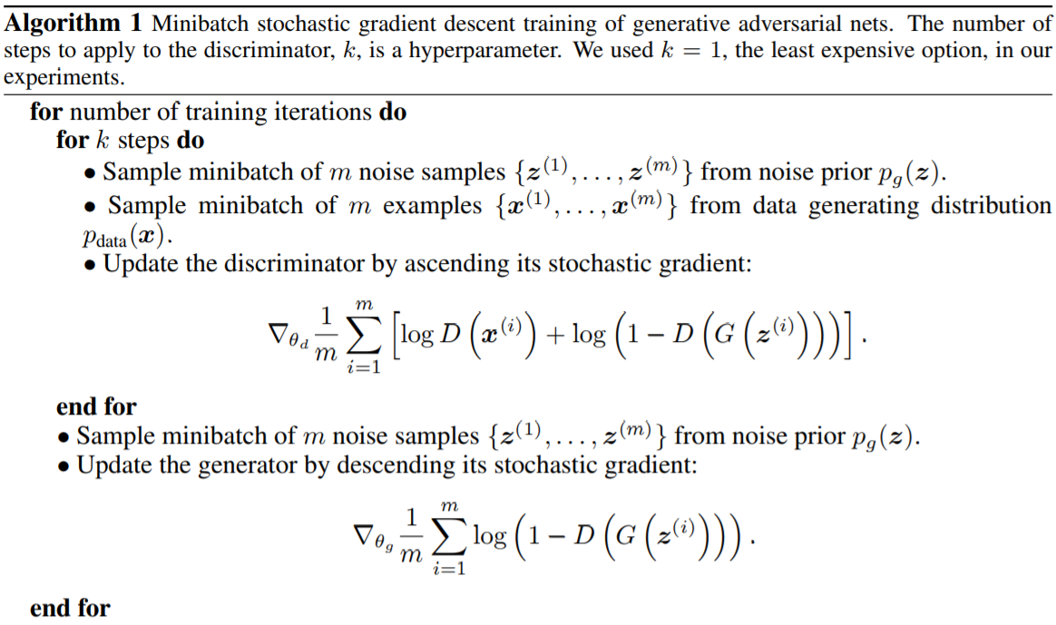
Algorithm for Training GANs
PYCON
THAILAND
Source: https://papers.nips.cc/paper/5423-generative-adversarial-nets

Slide 25
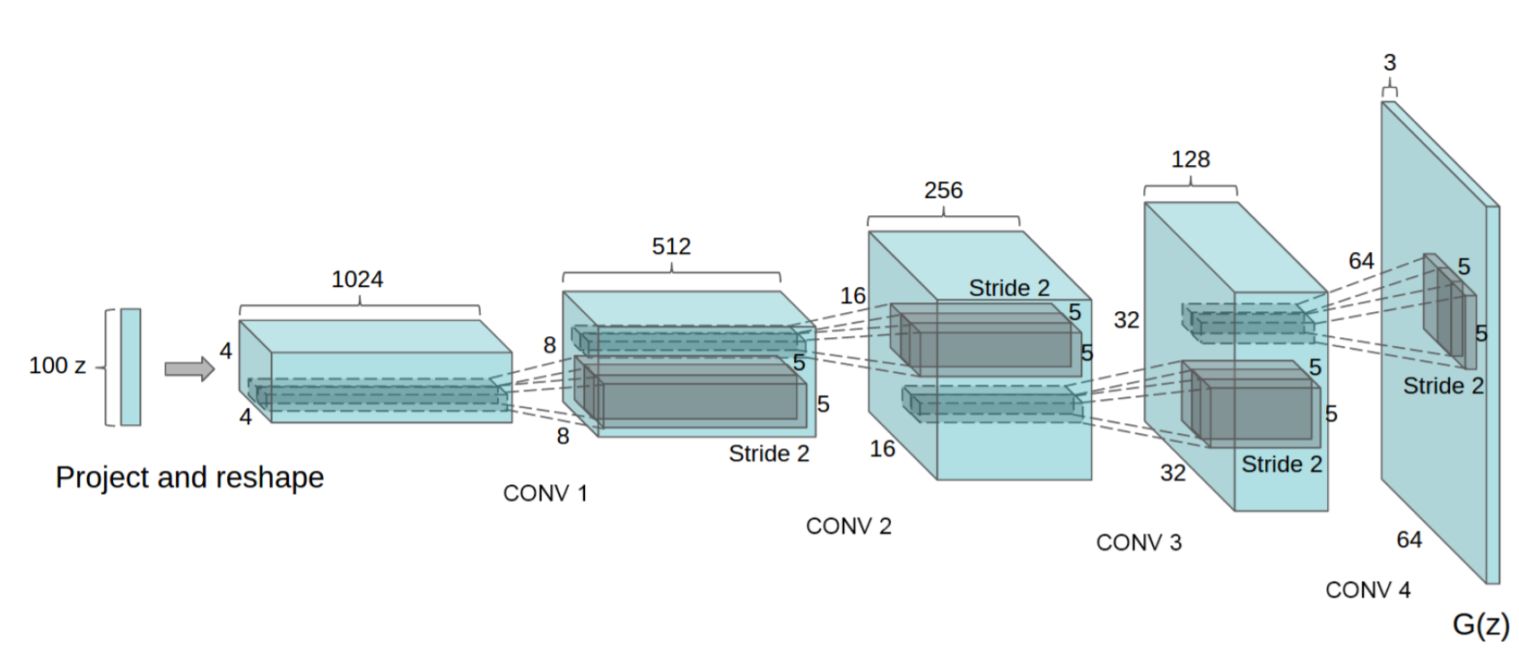
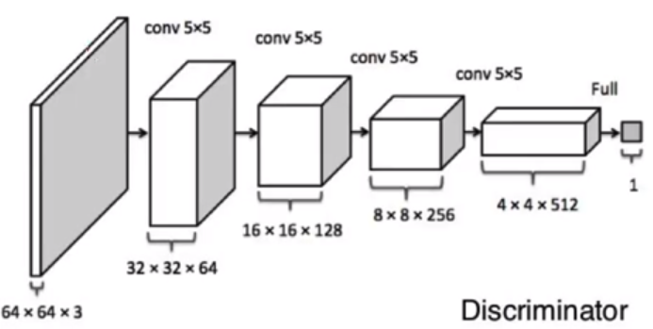
Architecture of DCGAN
PYCON
THAILAND
Source: https://arxiv.org/pdf/1511.06434.pdf

Slide 26
Time for a Quick Hands-on
PYCON
THAILAND
Let’s build our DCGAN (Deep Convolutional Generative Adversarial Network).
This GAN will try to generate digits like found in MNIST dataset.
Code available at: https://github.com/greatdevaks/PyCon_Thailand_2019_GANs_Anmol_Krishan_Sachdeva

Slide 27
Best Practices for DCGAN
PYCON
THAILAND
Replace the pooling layers with strided convolutions in the Discriminator and fractional-strided/transpose convolutions in the Generator.
Use Batch Normalization in both the Discriminator and the Generator.
Remove Fully Connected hidden layers from deeper architectures.
Use ReLU activation in the Generator for all the layers except for the output, which uses tanh activation.
Use Leaky ReLU activation in the Discriminator for all the layers.

Slide 28
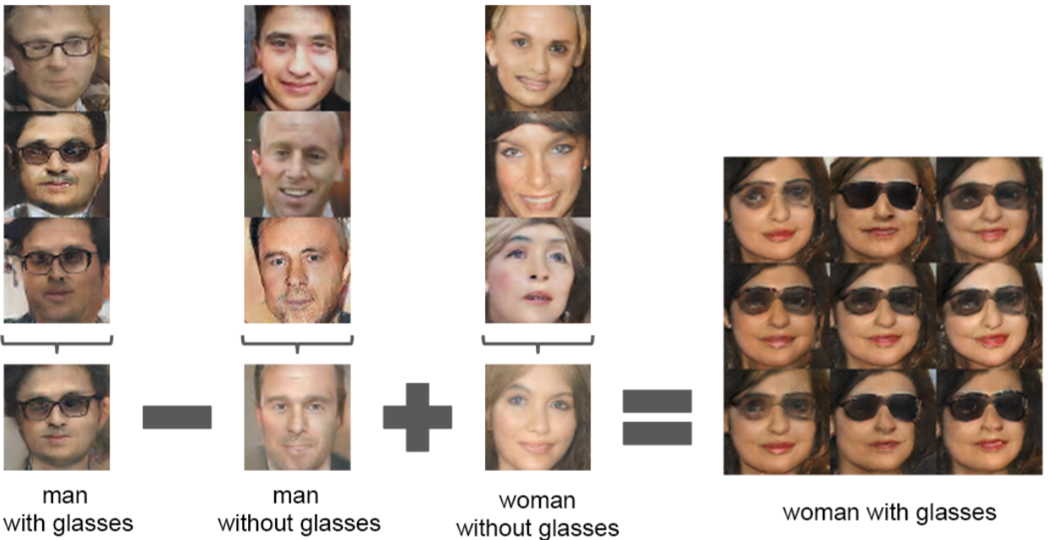
Applications of GANs
PYCON
THAILAND
~ Vector Operations on Visual Objects:

Slide 29
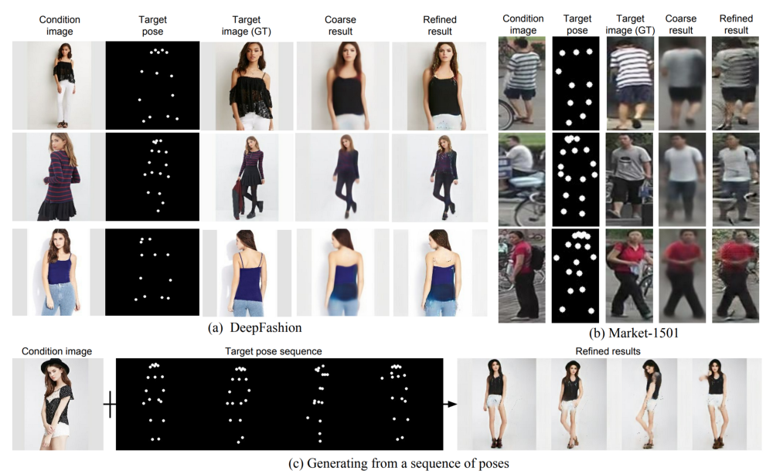
Continued…
PYCON
THAILAND
~ Pose Guided Image Generation:

Slide 30
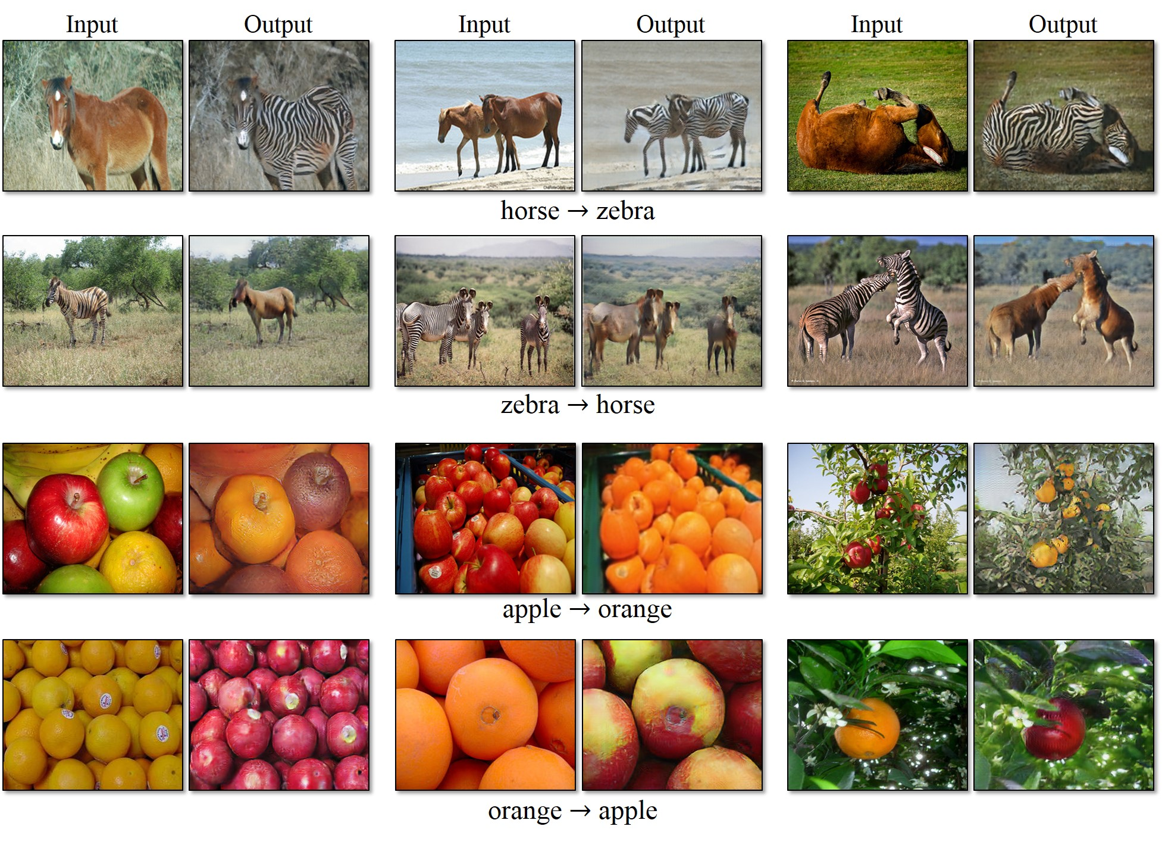
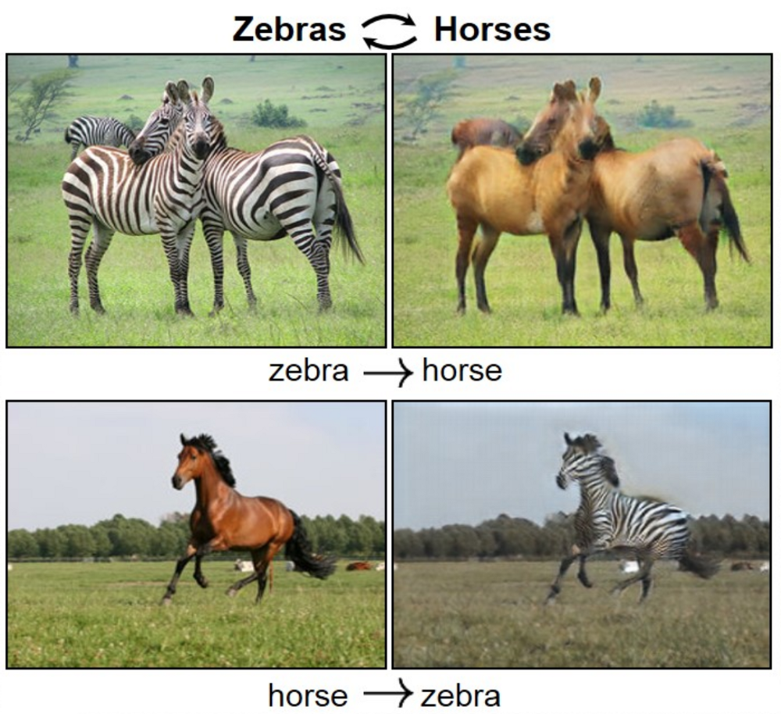
Continued…
PYCON
THAILAND
~ CycleGAN [Link]:

Slide 31
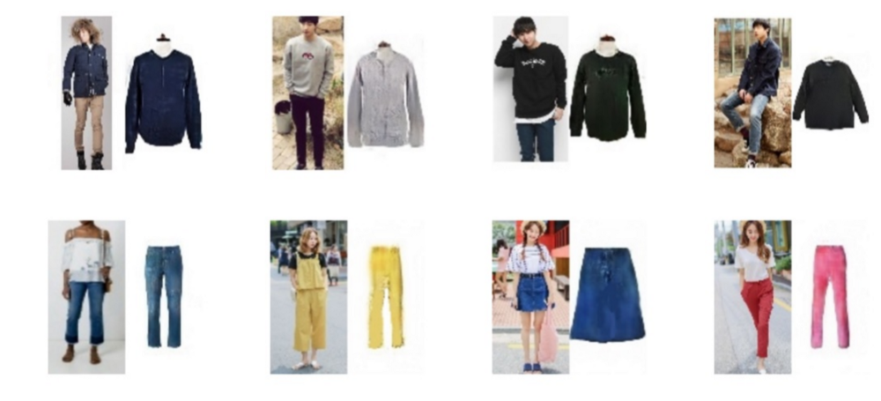
Continued…
PYCON
THAILAND
~ PixelDTGAN - Suggesting Merchandise based on Real Photos [Link]:

Slide 32
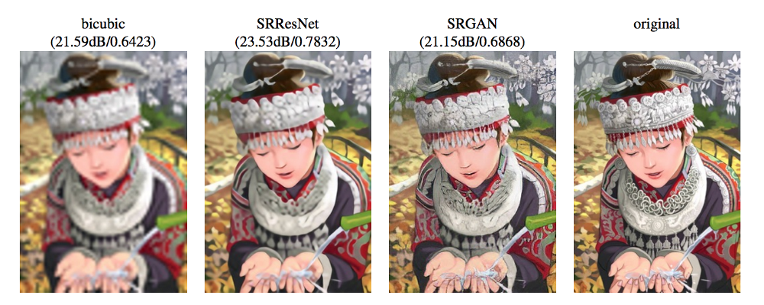
Continued…
PYCON
THAILAND
~ SRGAN [Link to Paper]:

Slide 33
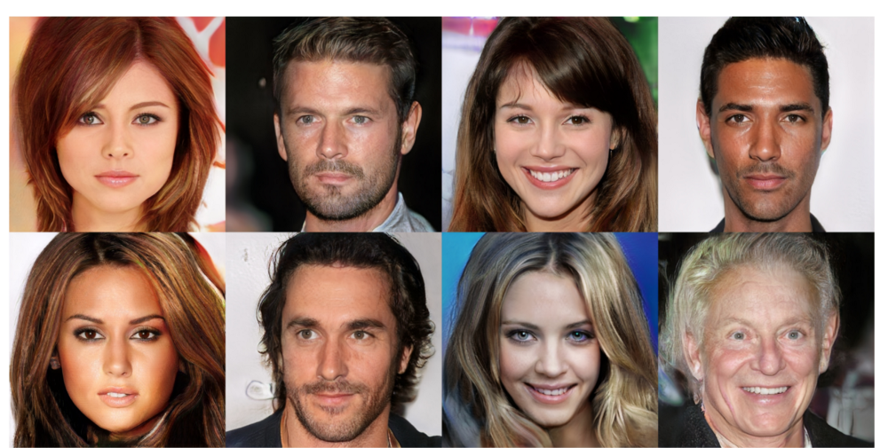
Continued…
PYCON
THAILAND
~ Progressive GAN - First Commercial-like Image Quality [Link to Paper]:

Slide 34
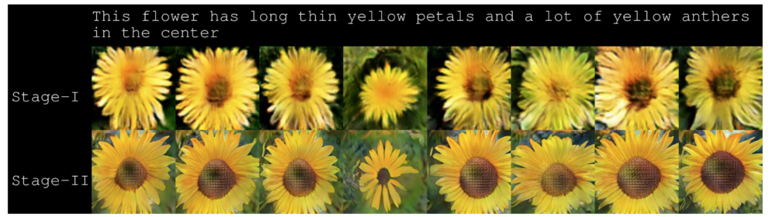
Continued…
PYCON
THAILAND
~ Test-to-Image using Stack GAN [Link]:

Slide 35
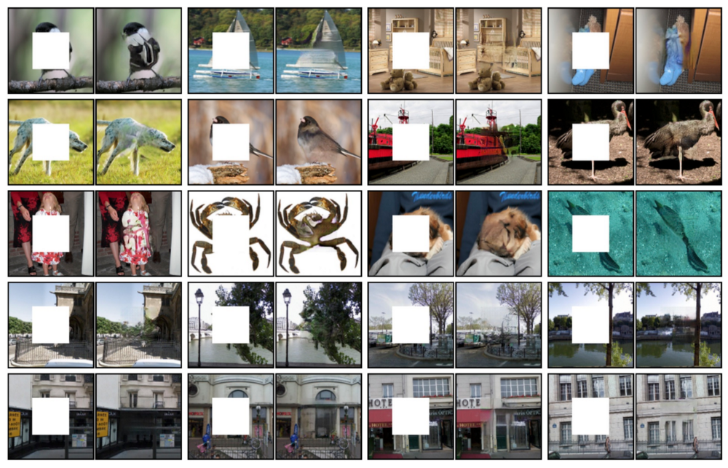
Continued…
PYCON
THAILAND
~ Image Inpainting using Context Encoder [Link]:

Slide 36
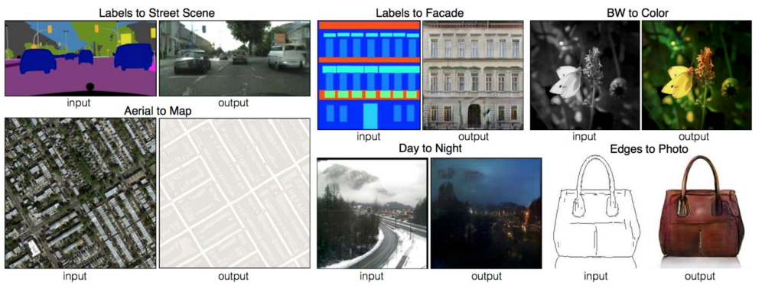
Continued…
PYCON
THAILAND
~ Image-to-Image Translation using Pix2Pix [Link]:

Slide 37



Acknowledgements
PYCON
THAILAND
I thank PyCon Thailand’s organizers and all the team members for making this happen.
I would like to thank Dr. Ian Goodfellow and all the researchers who have contributed towards the concept of GANs.
My sincere thanks to Prof. Cian O’Donnell, University of Bristol, UK and Prof. Carl Henrik Ek, University of Bristol, UK for imparting invaluable knowledge to me in this domain.
I would like to thank Bigbasket, India and all my team members for supporting and motivating me.

Slide 38
Catch Me Next At…
PYCON
THAILAND
Speaking at GeoPython, Basel, Switzerland [June 25 – 27, 2019].
Speaking at EuroPython, Switzerland [July 8 – 14, 2019].

Slide 39


Thanks a lot for being such a nice audience
PYCON
THAILAND
I WILL BE happy to answer YOUR questions…
Anmol Krishan Sachdeva
Platform Software Engineer - Bigbasket, India
MSc Advanced Computing, University of Bristol, UK
Email Id: greatdevaks@gmail.com
LinkedIn: https://www.linkedin.com/in/greatdevaks
Twitter: https://www.twitter.com/greatdevaks
GitHub: https://www.github.com/greatdevaks

Slide 40
Time For Feedback
PYCON
THAILAND
It will take only 2 minutes. I will be highly obliged if you fill the feedback form.
Link: https://greatdevaks.typeform.com/to/l9ycWM
Note: No personal details asked.

